Slide 1

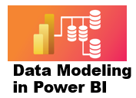



1 Introduction to Data Model
Prepared By :
Said Fawzy
Manager of Information Center
Tendering Department
Arab Contractors

Slide 2
1 Introduction to Data Model
Prepared By :
Said Fawzy
Manager of Information Center
Tendering Department
Arab Contractors

Slide 3

1
Introduction to Data Model
2
Model view in Power BI
3
Introduction to Schemas
4
Example of Schemas

Slide 4
5
Exercise 1: Configuring a Flat schema
6
Exercise 2: Configure a Flat schema with multiple sources

Slide 5
1
Introduction to Data Models

Slide 6
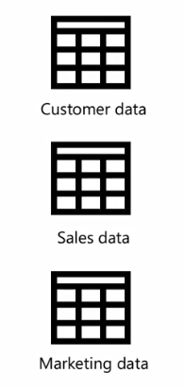
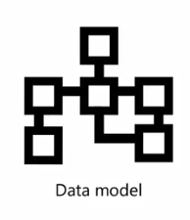


Integrating Data from Different Sources

Slide 7


Slide 8
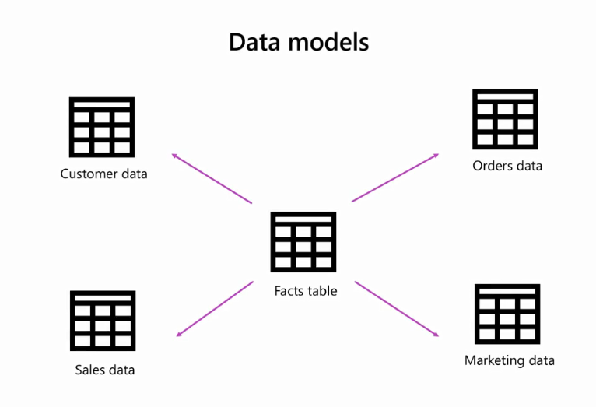

Slide 9


Slide 10

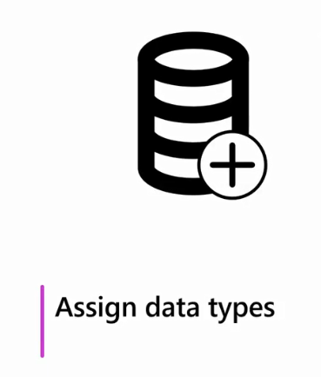
Power BI helps you to:

Slide 11

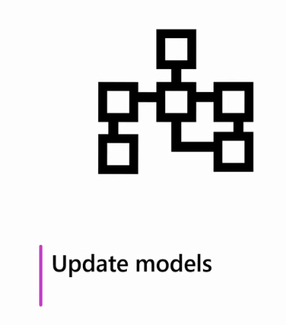
Power BI helps you to:

Slide 12


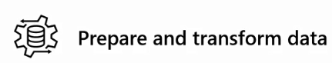
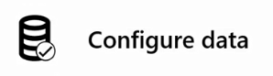

Slide 13



Slide 14

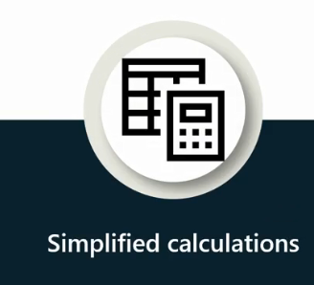


Advantages

Slide 15
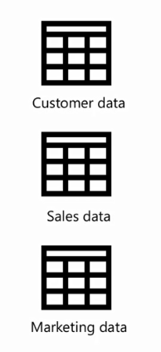
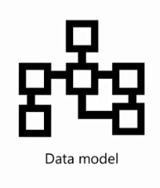

Steps to Create a Model
CTL using Power Query

Slide 16
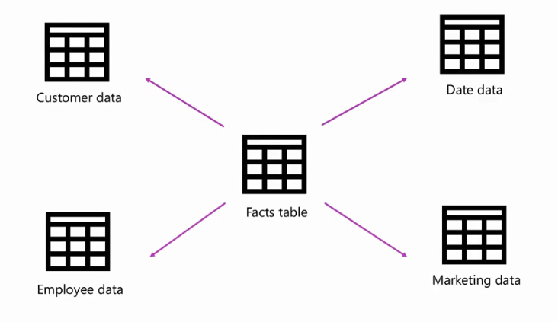
Steps to Create a Model
This Create a Data Model

Slide 17
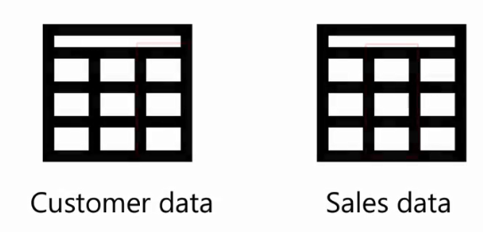
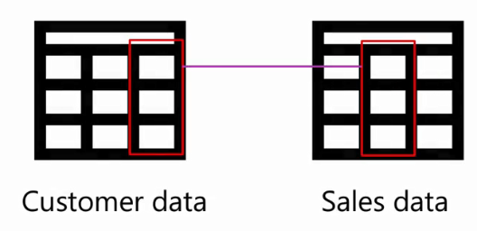
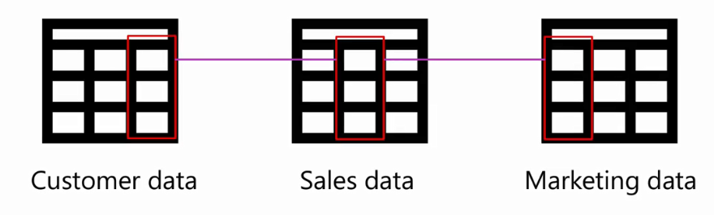
Steps to Create a Model
Define Relationship

Slide 18

Steps to Create a Model
Create Measures using DAX

Slide 19


Slide 20

Question
Your Company has tasked you with creating a data model to analyze sales data and improve the store's performance. What should your first step in the data modeling process be?
A. Configure column and table properties.
B. Prepare and transform your data.
C. Connect to your data sources.

Slide 21
ANSWER
Your Company has tasked you with creating a data model to analyze sales data and improve the store's performance. What should your first step in the data modeling process be?
A. Configure column and table properties.
B. Prepare and transform your data.
C. Connect to your data sources.

Slide 22
2
Model view in Power BI

Slide 23
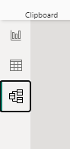
Model view elements
The Model view contains the following UI elements:
Diagram view (canvas)
Data pane
Properties pane
Home ribbon

Slide 24
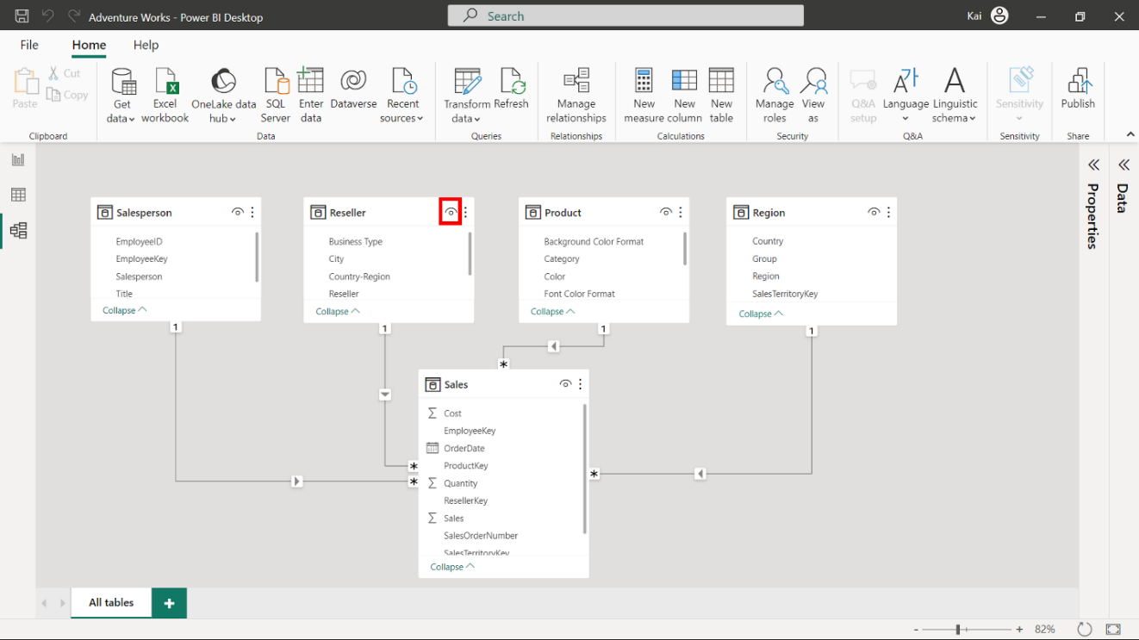
Diagram view (Canvas)
The small eye icon on the top right of the table diagram allows you to hide the table from the Power BI desktop report view

Slide 25

Diagram view (Canvas)
You can access more options by selecting the ellipses beside the eye icon of the table diagram.

Slide 26
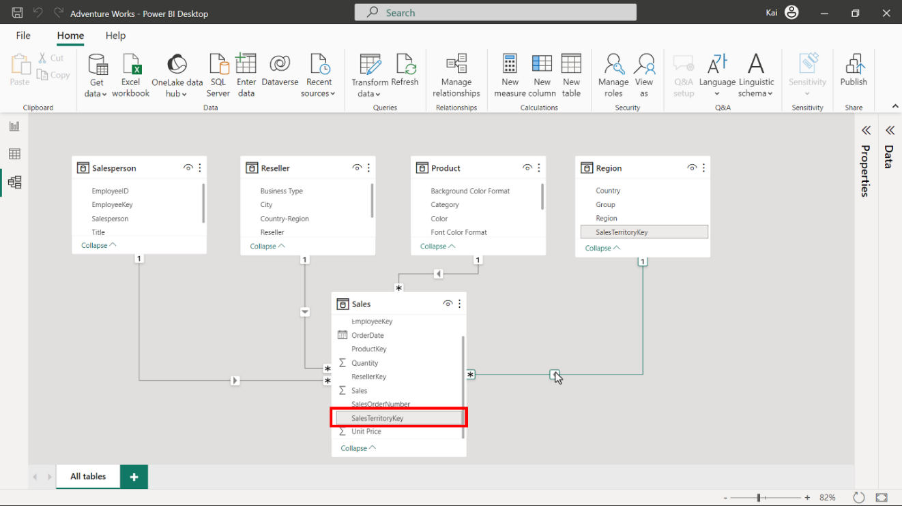
Fields
Fields are columns within your data tables.
In the Model view, these fields are listed under their respective tables.
All calculations (calculated columns and measures) also appear as fields in the data tables.

Slide 27
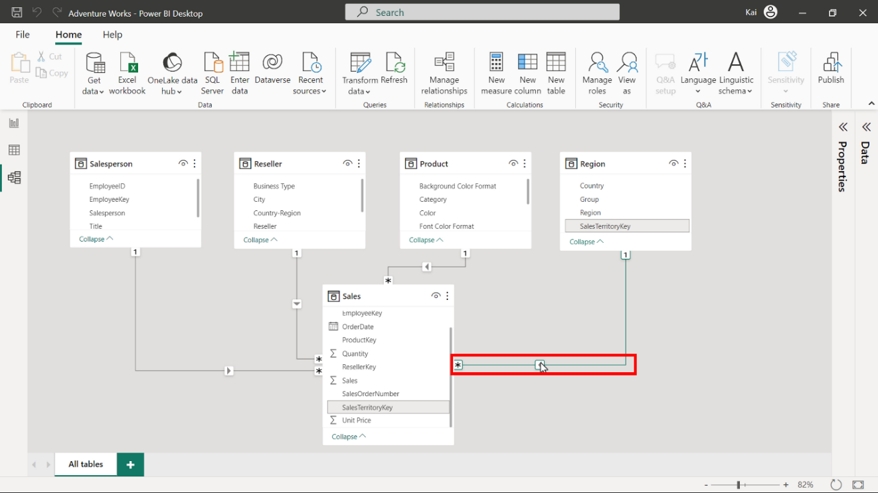
Relationships
Tables are related through a relationship line (connector line).
When you hover over the connector line, it highlights the fields used to establish the relationship.
The arrow on the connector line indicates the direction of the relationship (cross-filter direction).

Slide 28
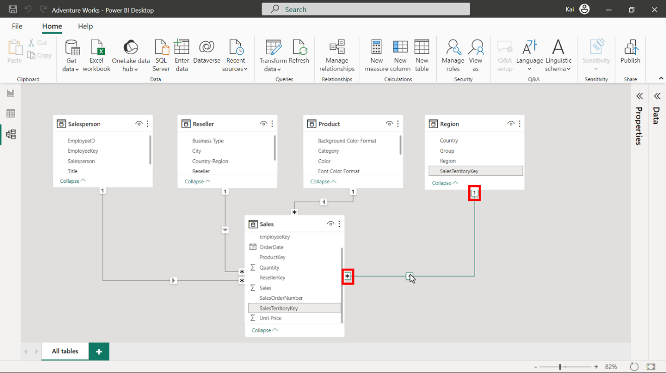
Relationships
The connector line connects two tables.
The 1 icon represents the one side of the relationship, while the * icon indicates the many side of the relationship

Slide 29
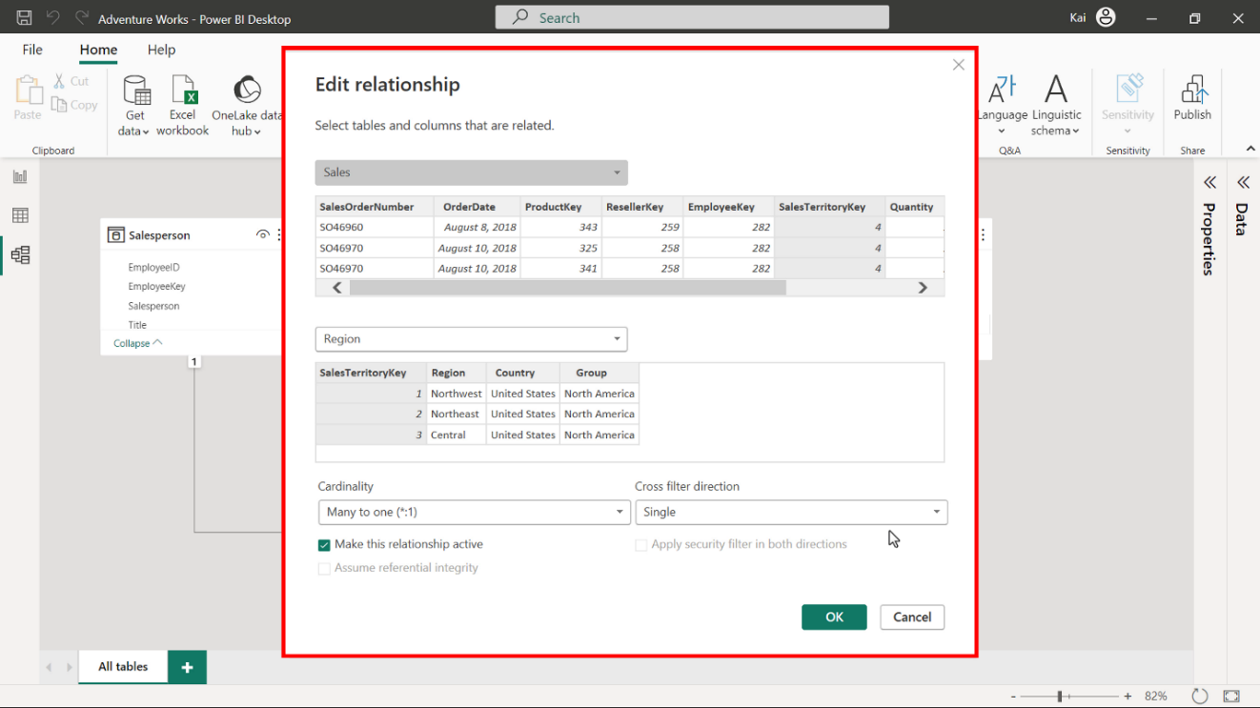
Relationships
You can select and double-click the connector line to open the Edit relationship window.
You can use this window to edit or configure the relationships between your data tables.

Slide 30
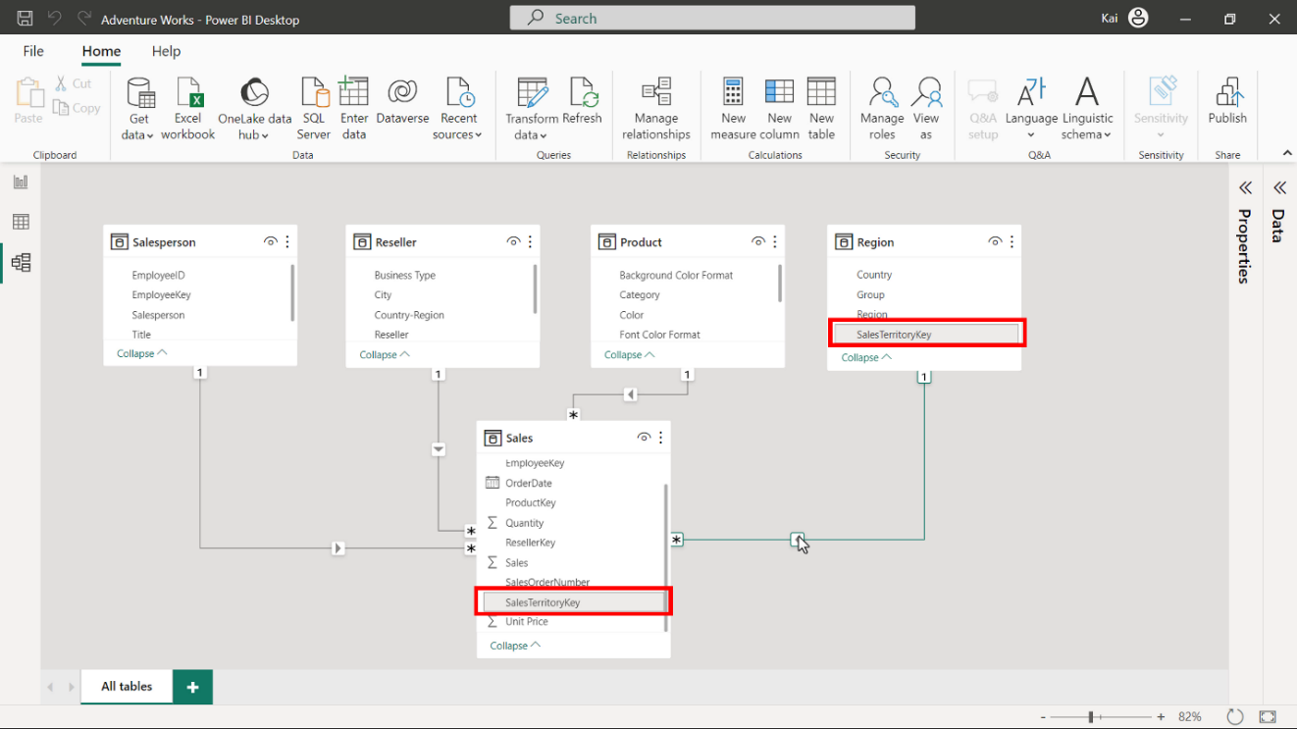
Relationships
When you load multiple tables into your data model, Power BI automatically detects their relationship based on the common key field.

Slide 31
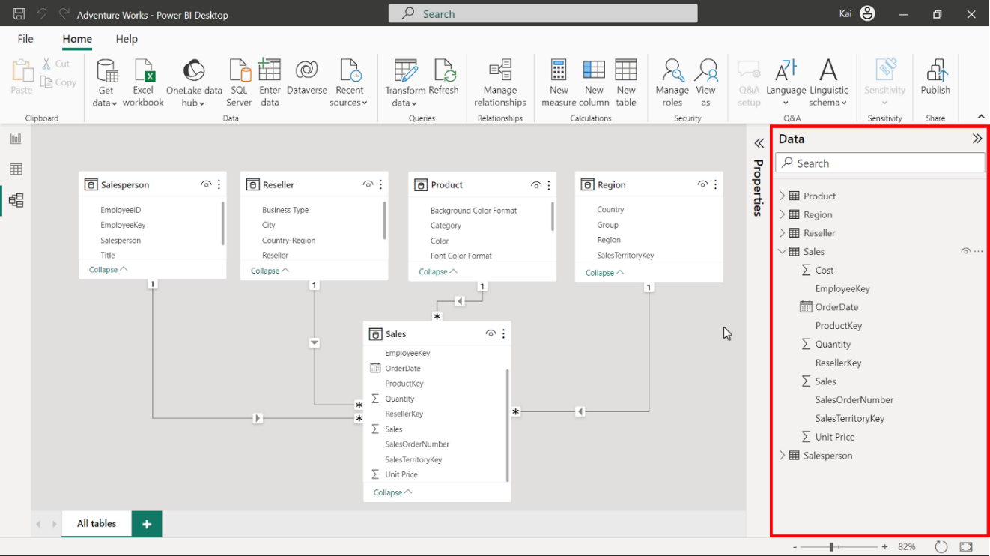
Data Pane
The Data pane is the common element in all three views of Power BI desktop (Report view, Data view, and Model view).
The Data pane lists all data tables and fields within the tables. All types of calculated tables, columns, and measures you will create are listed under the Data pane.
If your data model contains many tables, you can use the search bar to locate a specific data table.

Slide 32
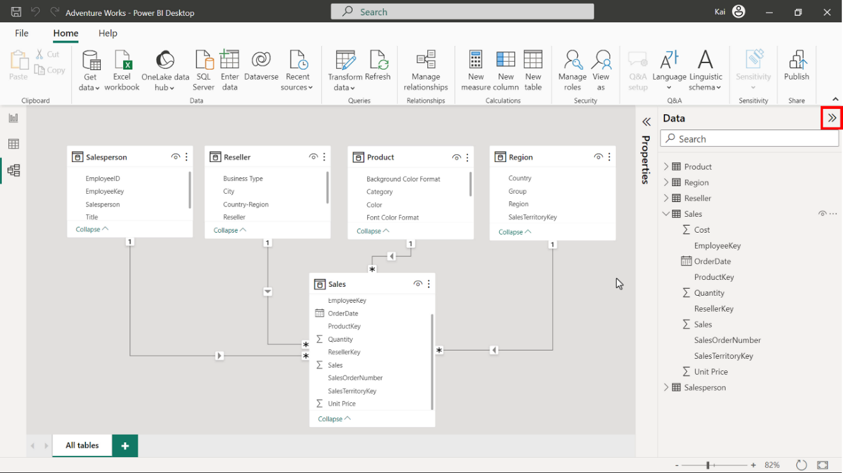
Data Pane
You can also expand or collapse the data pane by selecting the double arrow.

Slide 33
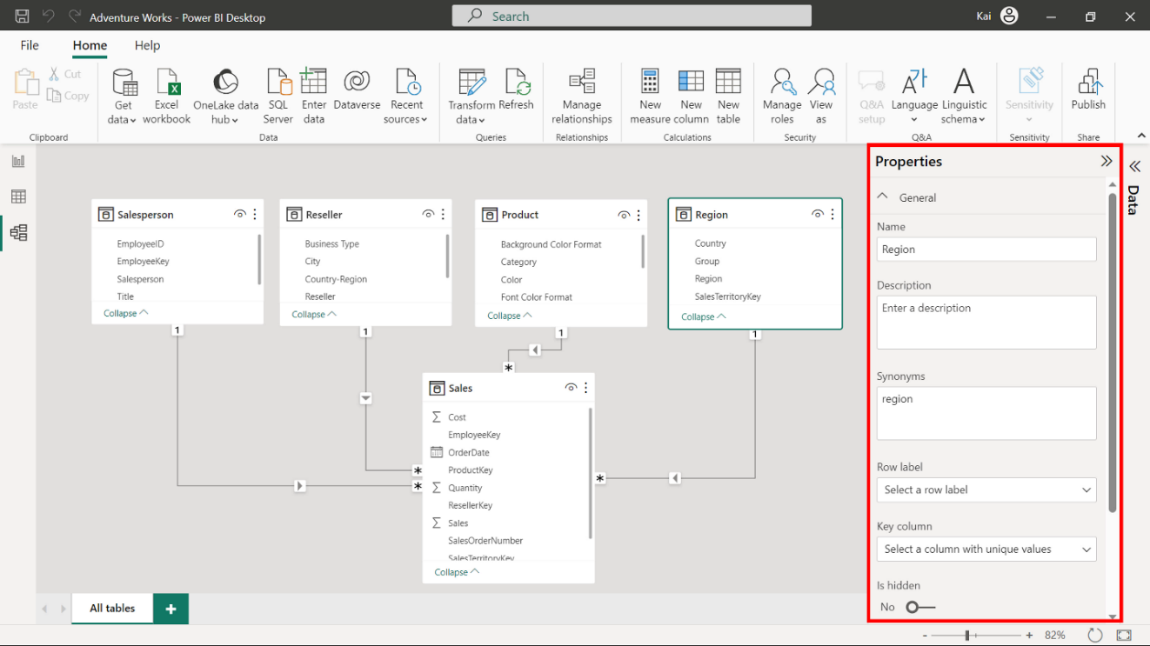
Properties pane
You can use the Properties pane to edit and configure table and column properties within your data model.
The pane has two sets of properties: General and Advanced.
You can use these properties to rename your table and columns, add descriptions, and configure other table and column properties

Slide 34
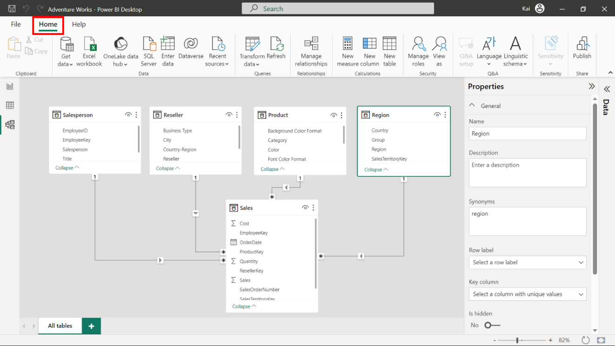
Home ribbon
The Home ribbon of the Model view offers a range of functions to shape and structure your data before preparing it for reports and visualizations.
Below is a list of the various groups of functions available in the Home ribbon.

Slide 35
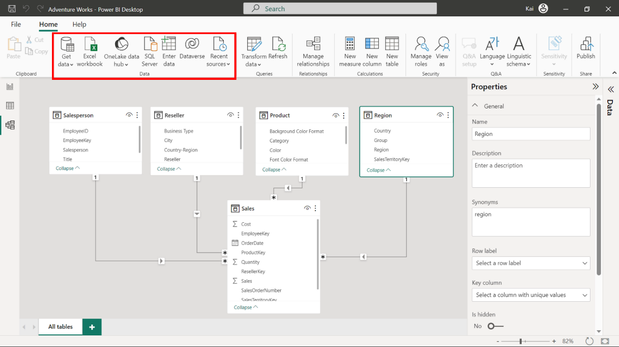
Home ribbon
Feature: Data
Explanation:
The Home tab’s Data group is like the Report view and Data view.
It offers data connectivity options for Power BI.

Slide 36
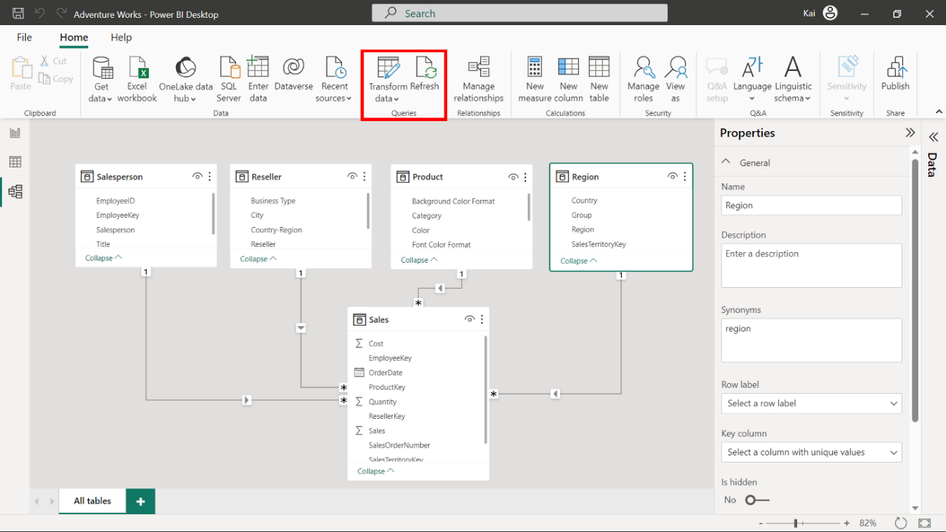
Home ribbon
Feature: Queries
Explanation: This section contains two elements:
Transform data redirects you to the Power Query editor, where you can perform necessary transformations on your data.
Refresh is used for data refresh. This is useful for when you change a dataset.

Slide 37
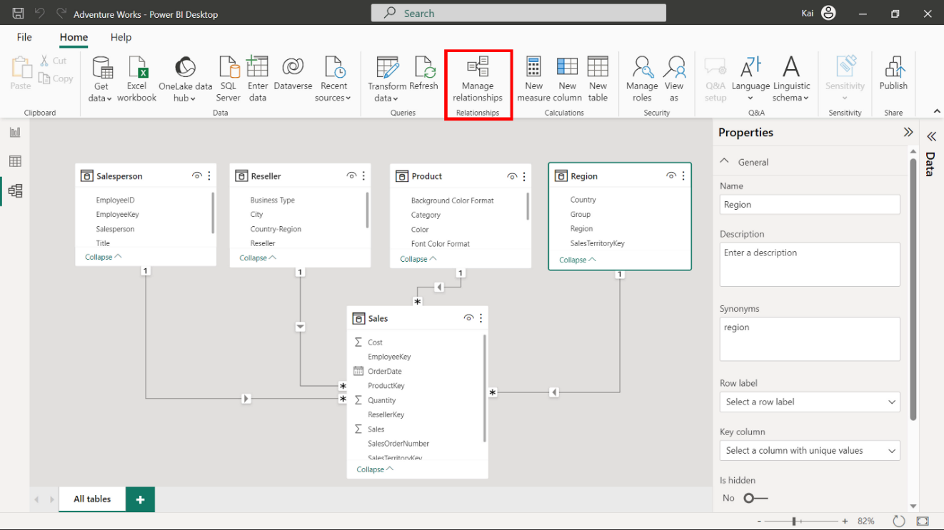
Home ribbon
Feature: Manage Relationships
Explanation: This is the only element in the relationships group that you can use to establish new relationships between data tables and edit existing relationships.

Slide 38
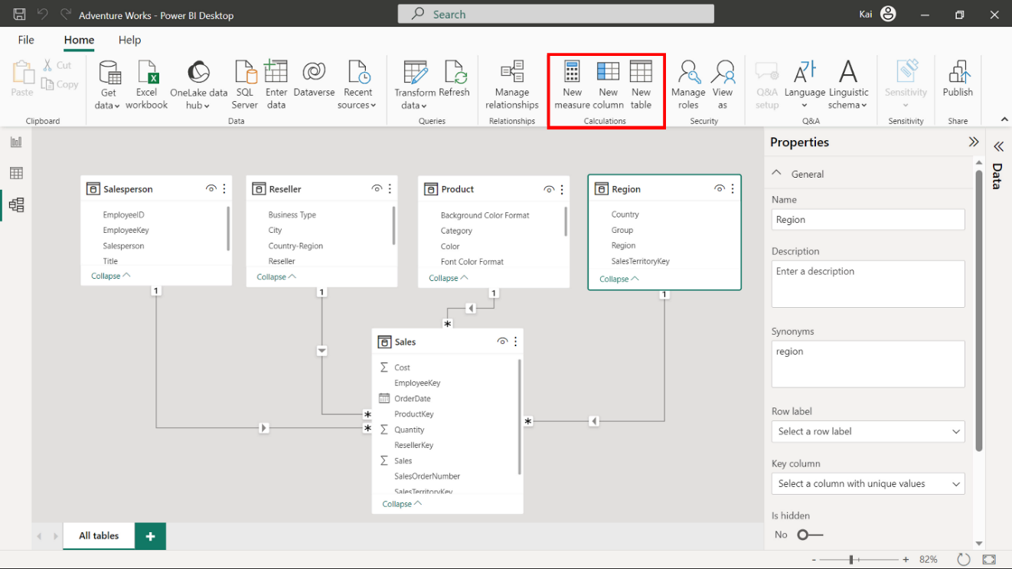
Home ribbon
Feature: Calculations
Explanation: You can use this group to add new custom calculations to your data model, like creating new tables, columns, and measures.
These calculations are created using a Power BI language called Data Analysis Expressions (DAX).
These calculations enable you to enhance your data analytic capabilities and uncover the information hidden in your data.

Slide 39
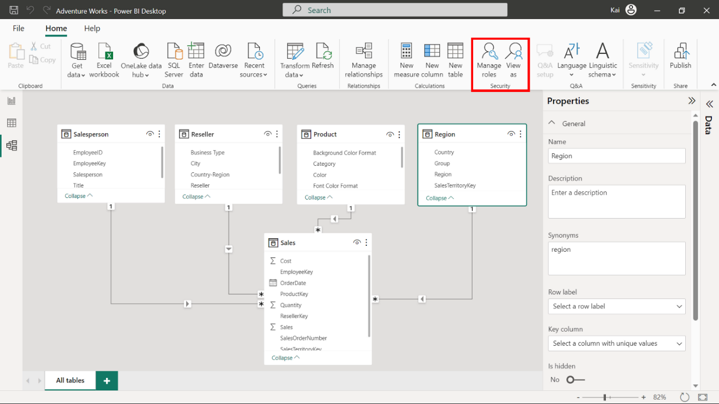
Home ribbon
Feature: Security
Explanation: You can use this feature to define roles and rules within Power BI desktop to restrict data access for certain users.
This provides you with better security for your data.

Slide 40
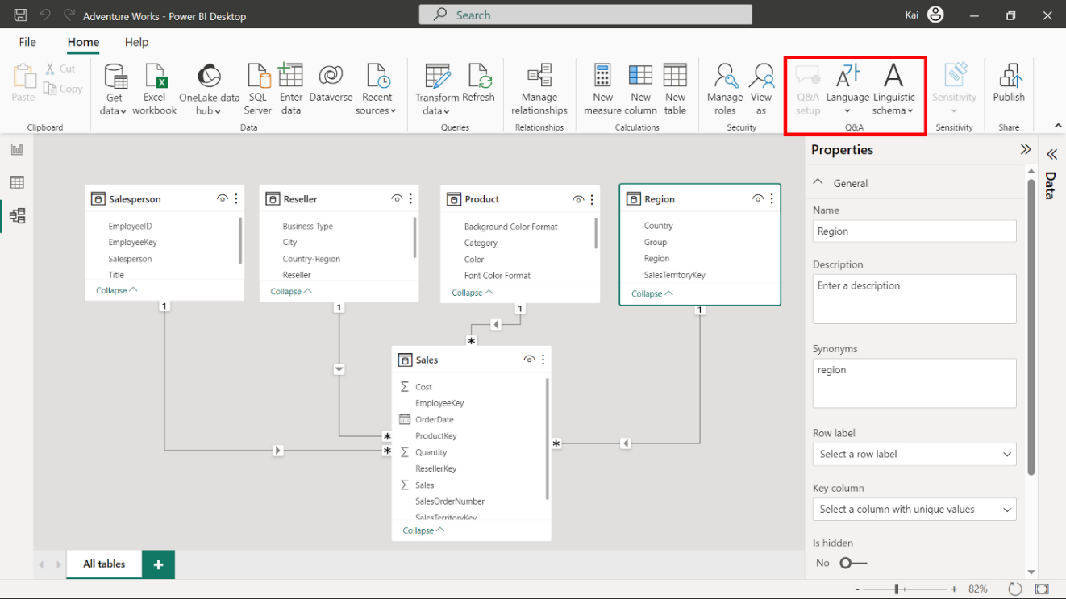
Home ribbon
Feature: Q&A
Explanation: Q&A (Question and Answer) is a powerful natural language query and visualization tool that you can use to interact with data more intuitively.

Slide 41
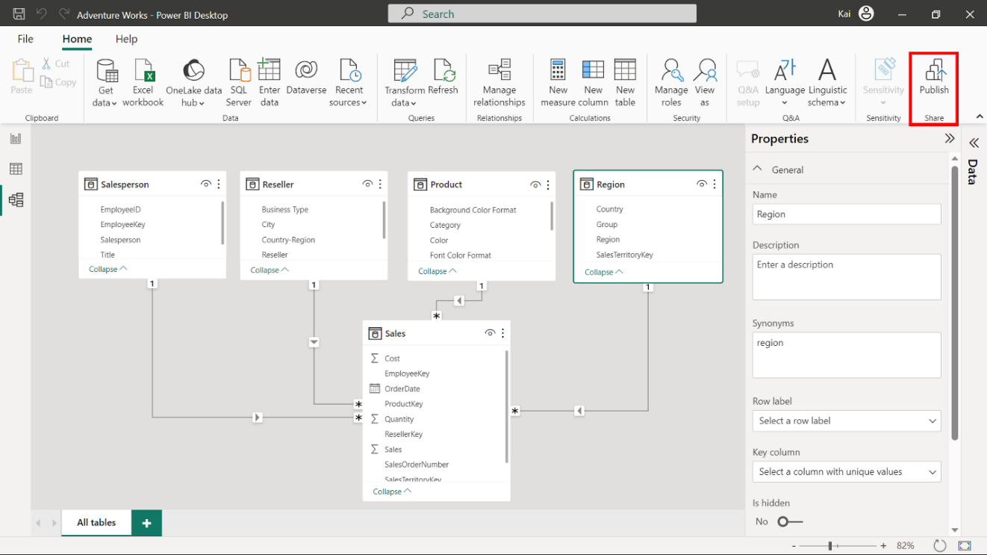
Home ribbon
Feature: Share
Explanation: You can use this element to share your report with other users within your team for effective collaboration

Slide 42
3
Introduction to Schemas

Slide 43
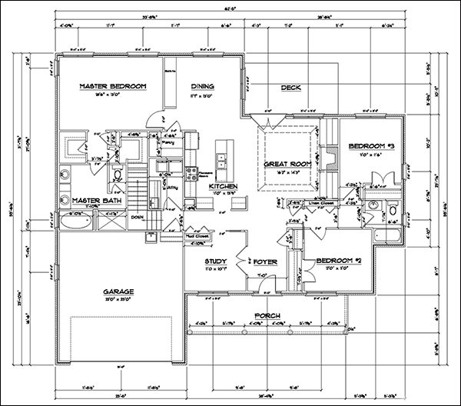
What is a Schema?
In the context of Power BI, a schema is a logical blueprint that defines the structure, organization, and relationships of tables.

Slide 44
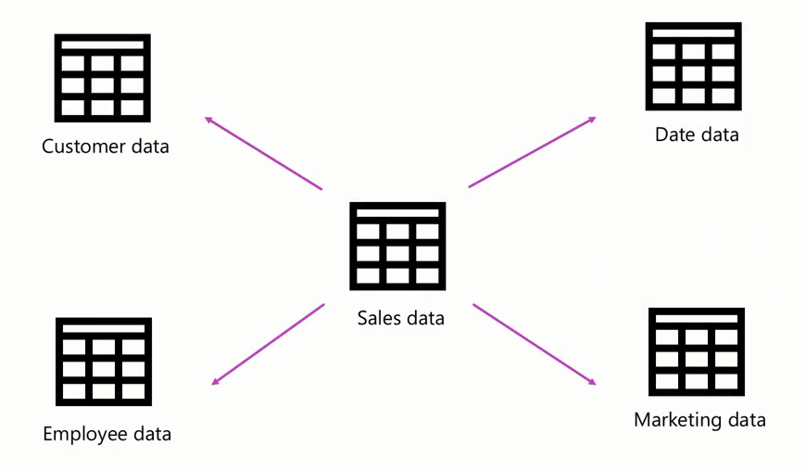
Company Schema

Slide 45


Slide 46
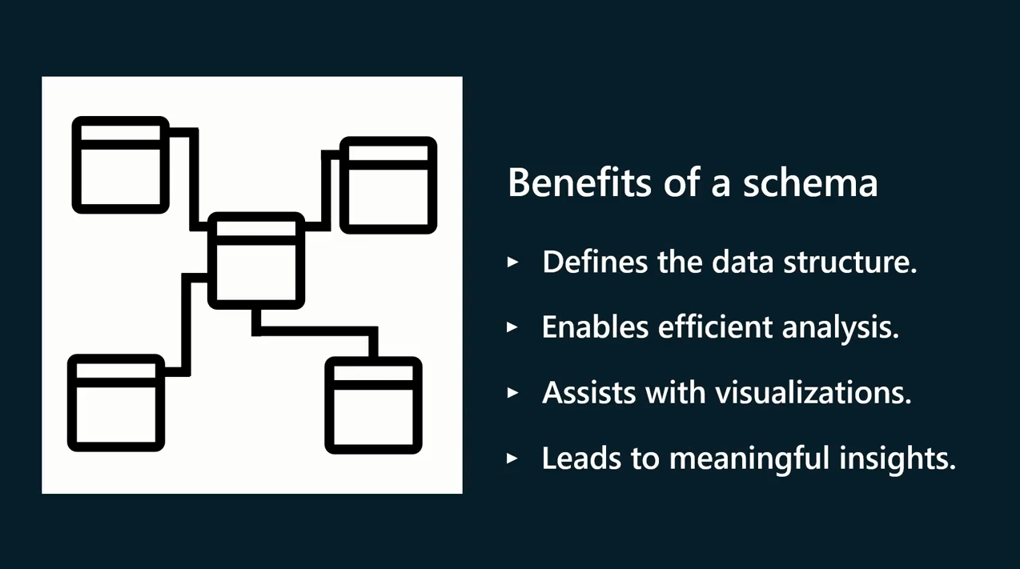

Slide 47
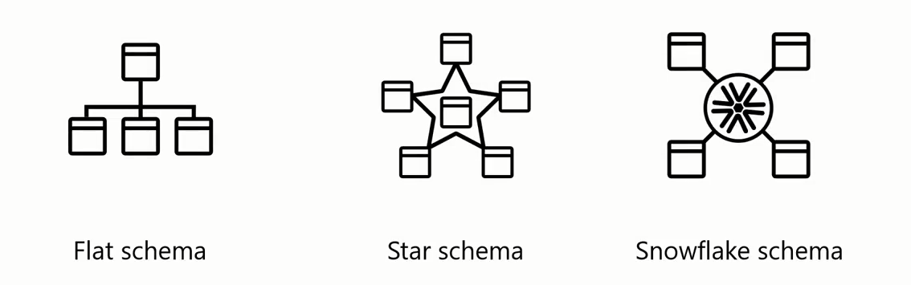
Types of Schema

Slide 48


Slide 49
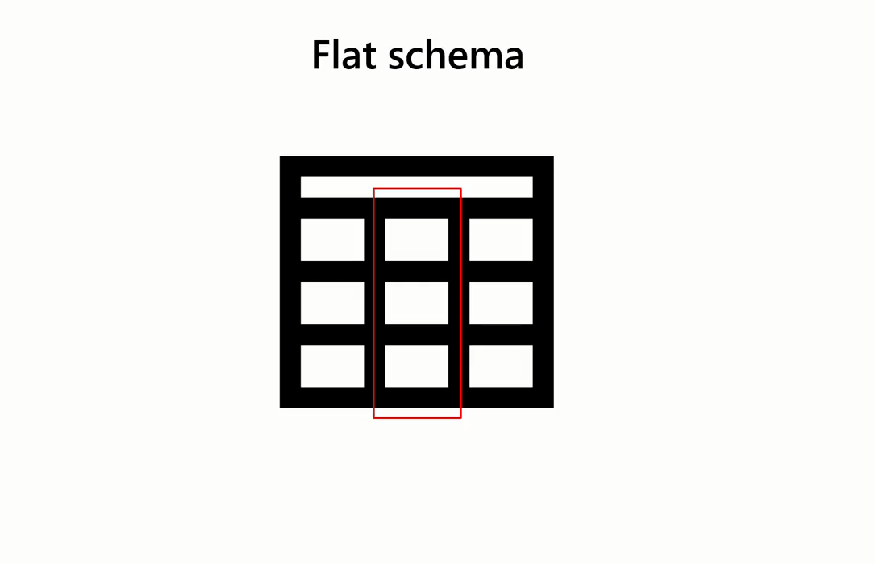

Slide 50
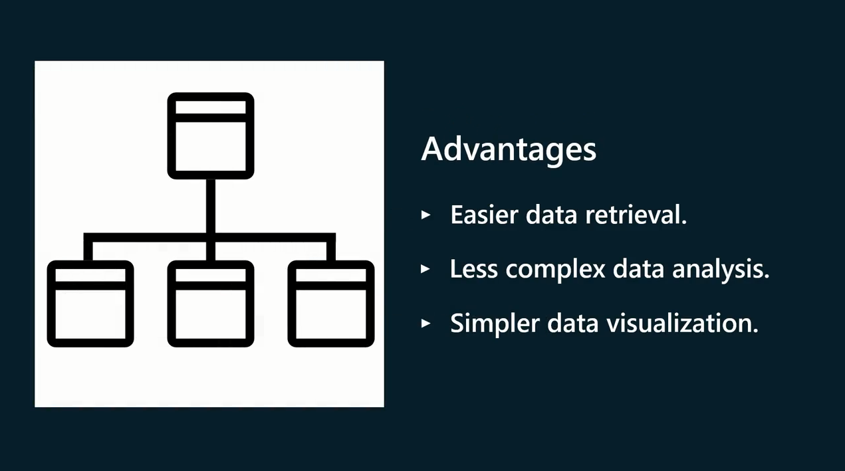

Slide 51
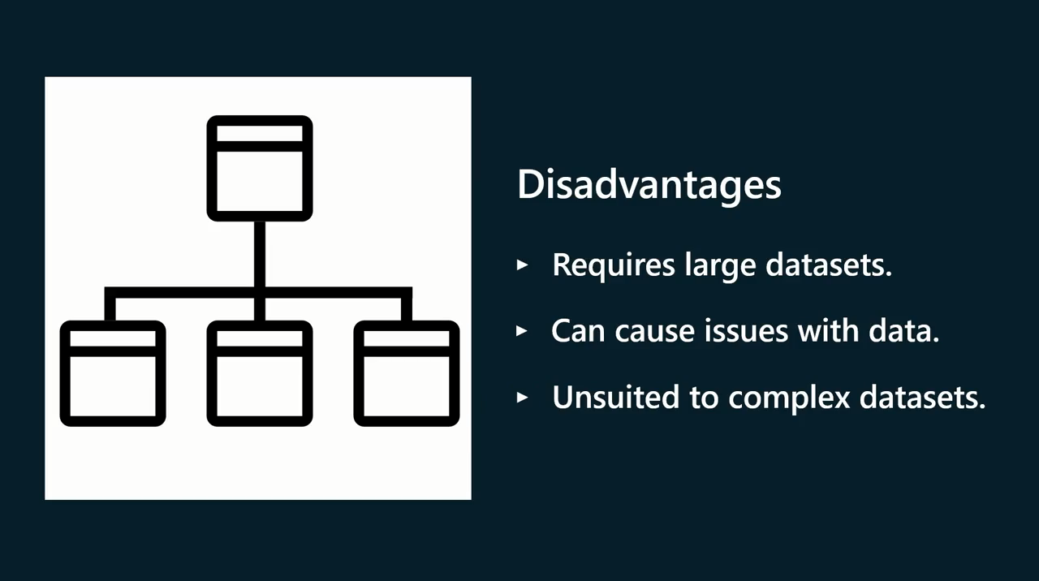

Slide 52


Slide 53
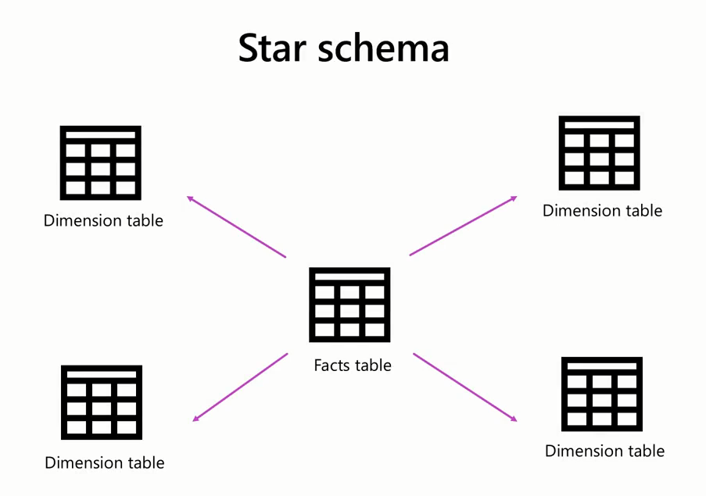

Slide 54
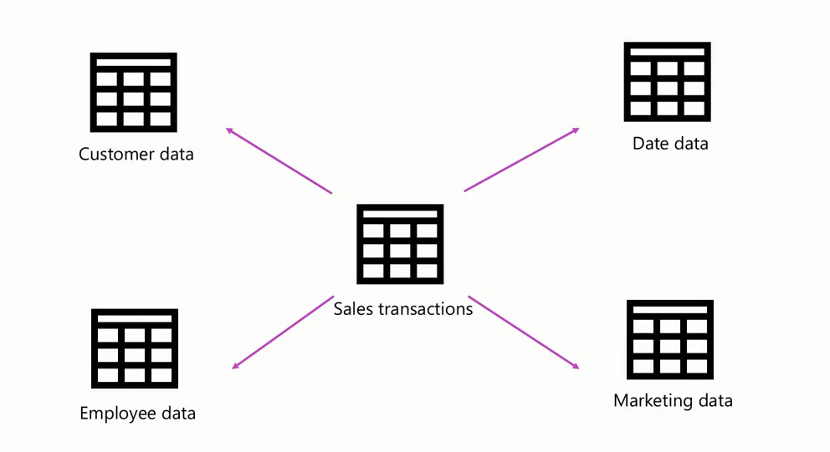

Slide 55
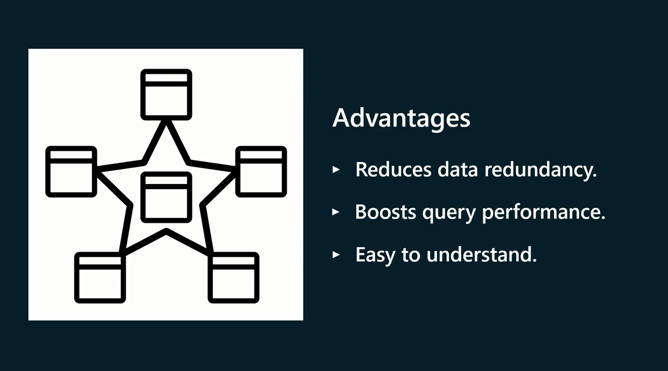

Slide 56
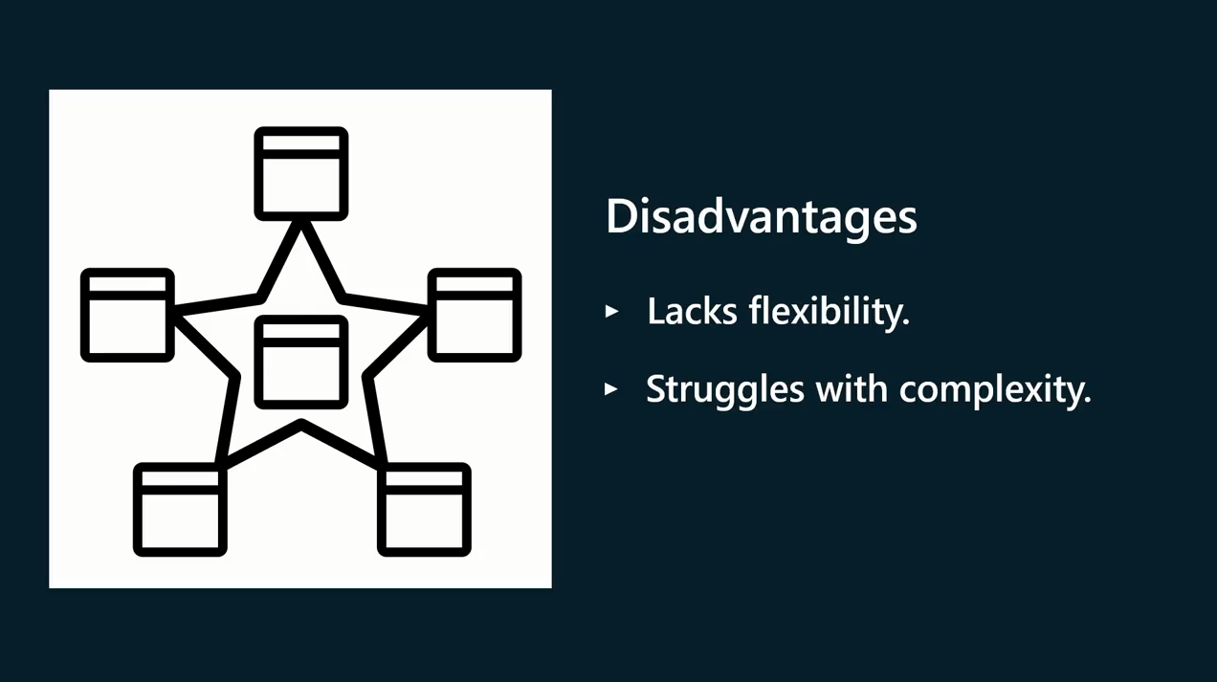

Slide 57


Slide 58
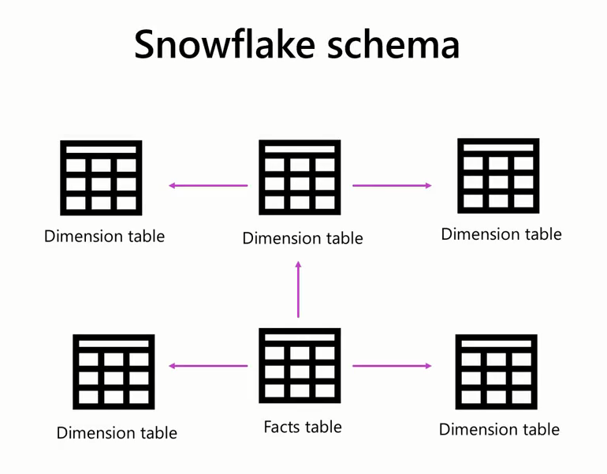

Slide 59
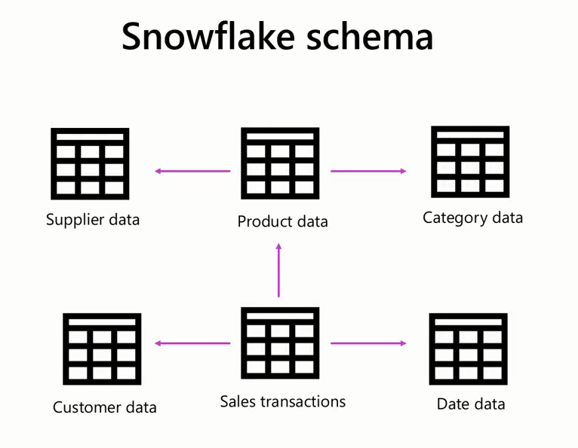

Slide 60
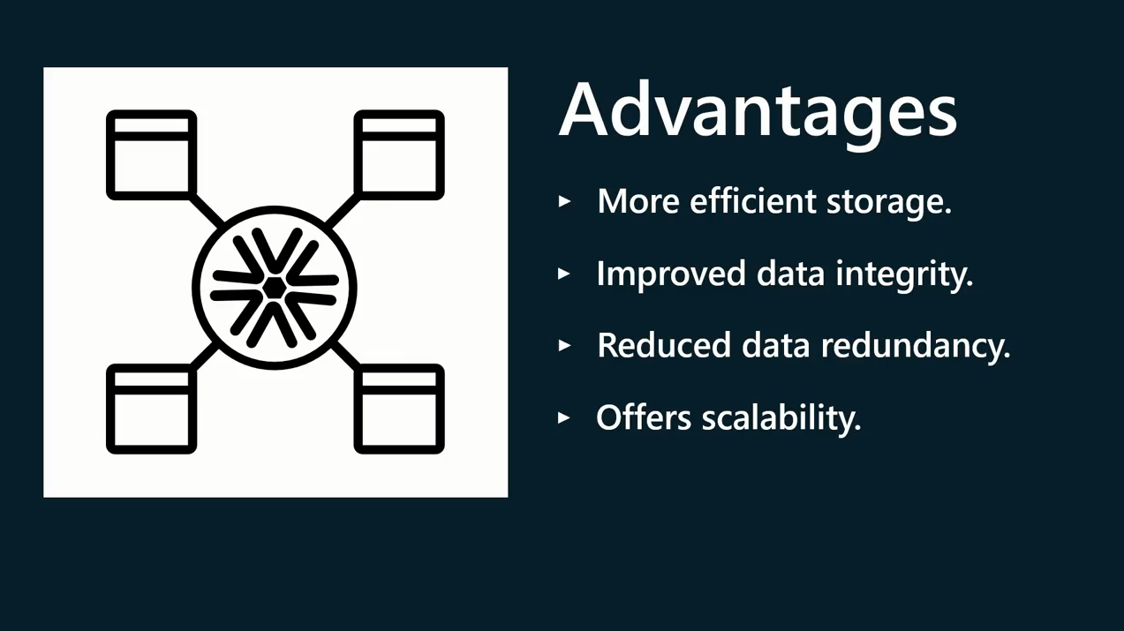

Slide 61
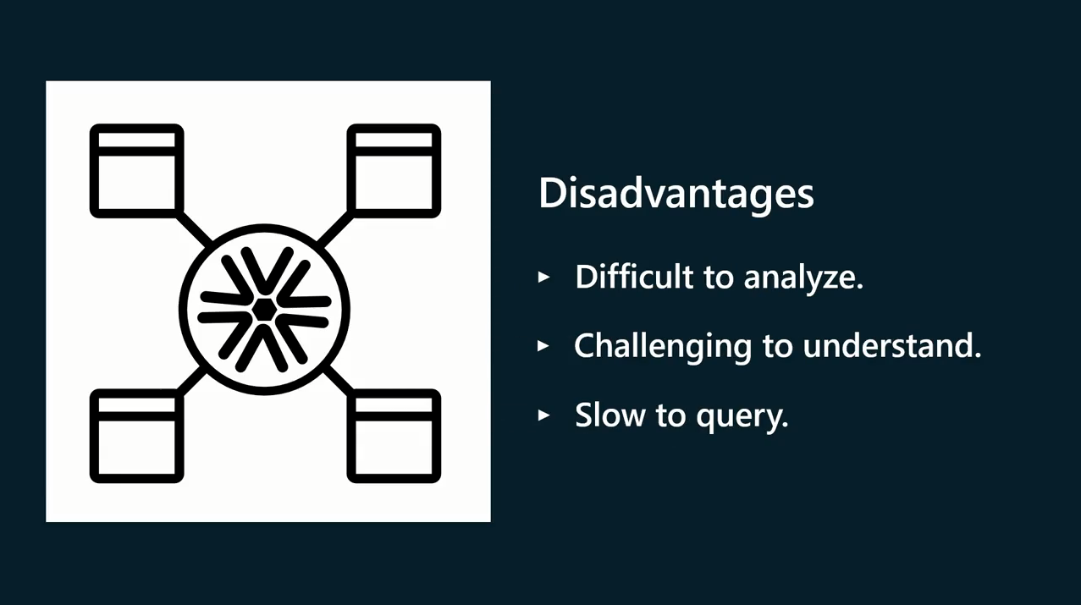

Slide 62
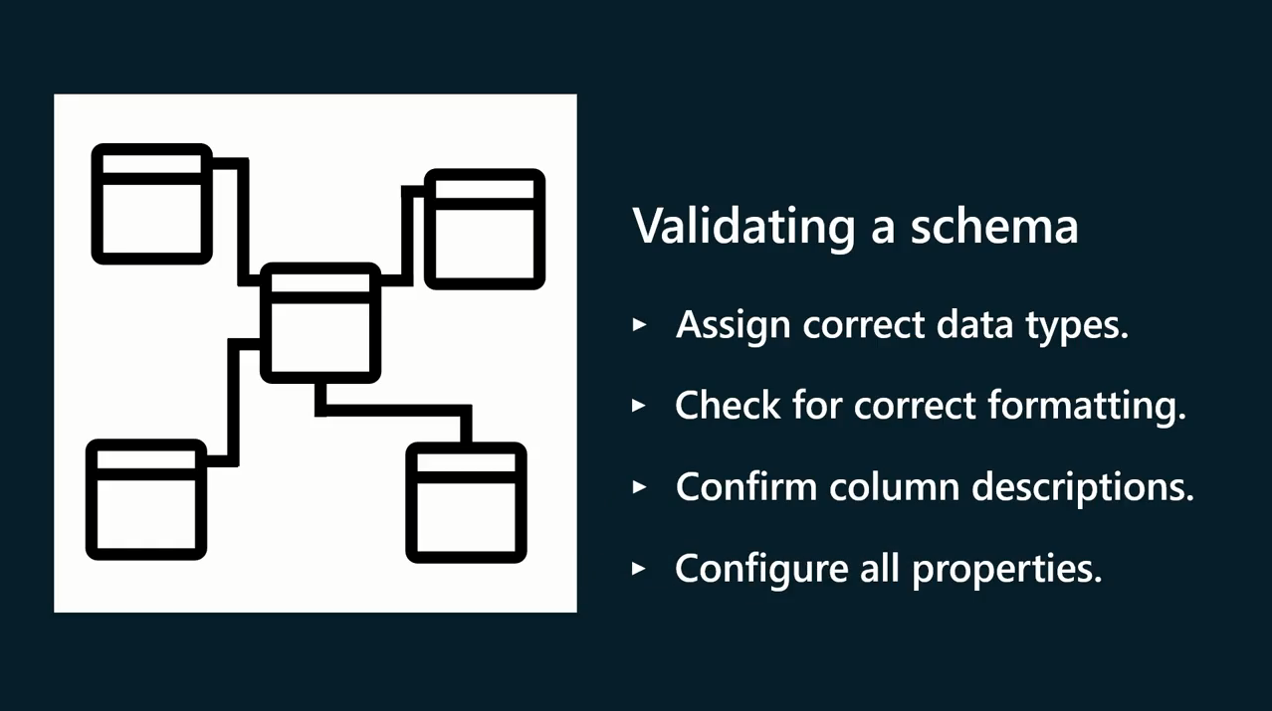

Slide 63
Question
Which of the following are benefits of a schema? Select all that apply.
A. A schema helps with generating meaningful insights into your data.
B. A schema helps with the creation of visualizations.
C. A schema helps to enable efficient data analysis.
D. A schema helps to define the structure of your data.

Slide 64
ANSWER
Which of the following are benefits of a schema? Select all that apply.
A. A schema helps with generating meaningful insights into your data.
B. A schema helps with the creation of visualizations.
C. A schema helps to enable efficient data analysis.
D. A schema helps to define the structure of your data.
A
B
C
D

Slide 65
4
Example of Schemas

Slide 66

Example of Company Schemas
A Company has decided to use Power BI for its data analytics.
The company must design a schema with several interconnected tables to analyze and visualize its data effectively.

Slide 67

Example of Company Schemas
Some of the tables in the company schema are as follows:
Reseller: A table with reseller ID, contact information, and demographic data.
Regions: Stores geographical location about the customers like region, country and city.
Sales: Captures transaction data like date, sale amount, transaction ID, and quantities sold.
Products: Stores data about various products, categories, and subcategories with Product ID.
Salesperson: Records data about salespersons, employee ID, hiring data, and designation

Slide 68
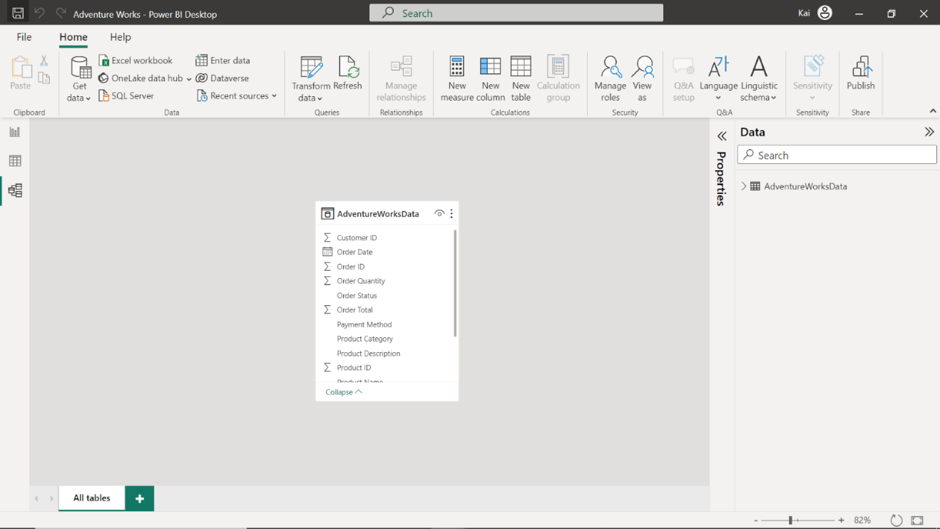
Flat Schema

Slide 69

Star Schema

Slide 70

Snowflake Schema

Slide 71
The importance of choosing the right schema
Understanding schemas and the available types is crucial for effective database design and management.

Slide 72

The importance of choosing the right schema
The Flat schema is simple and easy to work with but may not be suitable for complex data relationships or large datasets.

Slide 73

The importance of choosing the right schema
The Star schema is a popular choice for dimensional modeling, offering reduced data redundancy and intuitive design. Although it may be less flexible when handling complex relationships between dimensions.

Slide 74

The importance of choosing the right schema
Lastly, the Snowflake schema provides greater flexibility and improved data integrity through normalizing dimension tables. However, its complexity can make it more challenging to understand and query.

Slide 75

Exercise 1:
Configuring a Flat schema

Slide 76
Scenario
Adventure Works has seen a rise in customer complaints following incorrect and delayed deliveries. The company suspects inconsistencies in its data have caused the issues.
To fix these issues, Adventure Works needs to create a data model in Power BI that accurately and consistently organizes and integrates its data. You can help the company to develop this data model as a Flat schema.

Slide 77
Scenario
The company provides you with an Excel file called AdventureWorksDataSet. The file consolidates all required data into a table containing all relevant fields related to the company’s products and orders.
You must load this dataset into Power BI and develop it as a Flat schema. Be sure to evaluate the data quality and configure the model to ensure that Adventure Works can use it to make informed decisions.

Slide 78
Steps:
Step 1: Explore the Excel File.
Step 2: Connect to the Excel workbook and load the data into Power BI.
Step 3: Configure the table properties.
Step 4: Configure Column Properties.

Slide 79
Question 1
Exercise Questions
Which of the following steps are essential to ensure a well-structured and accurate flat table schema? Select all that apply.
A. Connecting to data sources.
B. Validating the schema.
C. Configuring column properties.
D. Merging all tables into a single table.

Slide 80
ANSWER 1
Exercise Questions
Which of the following steps are essential to ensure a well-structured and accurate flat table schema? Select all that apply.
A. Connecting to data sources.
B. Validating the schema.
C. Configuring column properties.
D. Merging all tables into a single table.
A
B
C

Slide 81
Question 2
Exercise Questions
How many tables were displayed in the Model View once the dataset was loaded?
A data structure that included multiple related tables.
A single table with multiple columns that included different data.
A single table with one-to-many relationships.

Slide 82
ANSWER 2
Exercise Questions
How many tables were displayed in the Model View once the dataset was loaded?
A data structure that included multiple related tables.
A single table with multiple columns that included different data.
A single table with one-to-many relationships.

Slide 83
Question 3
Exercise Questions
How many rows were present in the dataset after all duplicate rows were removed from the OrderID column in the Adventure Works dataset?
96
48
37

Slide 84
ANSWER 3
Exercise Questions
How many rows were present in the dataset after all duplicate rows were removed from the OrderID column in the Adventure Works dataset?
96
48
37

Slide 85
Question 4
Exercise Questions
What was the data type of the Product Price column after you loaded the data to Power BI before applying a transformation to the dataset?
Date
Decimal Number
Whole Number
Text

Slide 86
ANSWER 4
Exercise Questions
What was the data type of the Product Price column after you loaded the data to Power BI before applying a transformation to the dataset?
Date
Decimal Number
Whole Number
Text

Slide 87
Exercise 2:
Configure a Flat schema with multiple sources

Slide 88
Scenario
Adventure Works’ system saves sales records into a dataset with attributes like product, category, and unit price. On the other hand, the records of Adventure Works sales team employees are stored in a separate table called Salespersons.
Adventure Works wants to analyze the performance of its sales team. So, it needs to create a data model in Power BI that accurately and consistently organizes and integrates sales data alongside the records of its sales team. You can help the company to develop this data model as a Flat schema.

Slide 89
Scenario
The company provides you with an Excel file called AdventureWorksDataSet. The file contains two tables called Sales and Salespersons.
You must combine both tables into a consolidated dataset containing all relevant fields related to the company's sales data and sales team.
You must load this dataset into Power BI and develop it as a Flat schema.
Be sure to combine the data tables and configure the model to ensure that Adventure Works can use it to make informed decisions.

Slide 90
Steps:
Step 1: Explore the Excel File.
Step 2: Connect to the Excel workbook and load the data into Power BI.
Step 3: merge the tables into one dataset.
Step 4: Configure table and column properties.

Slide 91


Slide 92
Question 1
In Power BI, relationships are established between the tables based on _____________ that match between the tables.
Column fields
Table properties
Rows

Slide 93
ANSWER 1
In Power BI, relationships are established between the tables based on _____________ that match between the tables.
Column fields
Table properties
Rows

Slide 94
Question 2
What is the primary characteristic differentiating a Snowflake schema from a Star schema?
Denormalized dimension tables.
A hierarchical structure.
A central Fact table.
Normalized dimension tables.

Slide 95
ANSWER 2
What is the primary characteristic differentiating a Snowflake schema from a Star schema?
Denormalized dimension tables.
A hierarchical structure.
A central Fact table.
Normalized dimension tables.

Slide 96
Question 3
What are the limitations of using a Flat schema in Power BI? Select all that apply.
A Flat schema cannot be used to perform aggregations.
A Flat schema offers a lack of flexibility for organizing data from multiple sources.
A Flat schema offers limited capacity for storing large volumes of data.

Slide 97
ANSWER 3
What are the limitations of using a Flat schema in Power BI? Select all that apply.
A Flat schema cannot be used to perform aggregations.
A Flat schema offers a lack of flexibility for organizing data from multiple sources.
A Flat schema offers limited capacity for storing large volumes of data.
B
C

Slide 98
Question 4
True or False: In Power BI, a schema is automatically created when you import data from various sources and establish relationships between tables.
True
False

Slide 99
ANSWER 4
True or False: In Power BI, a schema is automatically created when you import data from various sources and establish relationships between tables.
True
False

Slide 100
Question 5
Which property cannot be adjusted for a table or column in Power BI?
Table relationship
Data type
Sort order

Slide 101
ANSWER 5
Which property cannot be adjusted for a table or column in Power BI?
Table relationship
Data type
Sort order

Slide 102


